Slide 1

SOCIAL CATEGORY
PAK ANGELS FINAL HACKATHON
ManOSalwaKnot
Rescue extra food. Feed real people.
A food rescue network that connects kitchens with surplus food to people nearby, quickly and safely.
TEAM MEMBERS
Eman Aslam Khan
Muhammad Tanveer
Tehniat Fatima Khan
Sahil Kumar
Team Leader
Team Member
Team Member
Team Member

Slide 2
Outline
1
Introduction
6
Methodology (Architecture and AI Agents)
2
Problem Statement
7
Technology Stack
3
Objectives
8
Live Demo
4
Significance and Contribution
9
Limitations and Next Steps
5
How It Works (Flow Diagram)
10
Conclusion and Q/A
ManOSalwaKnot | Social Category | Pak Angels Final Hackathon
2

Slide 3
Introduction
Restaurants, wedding halls and bakeries often end up with good food that nobody will eat.
At the same time, many families around them struggle to afford enough meals.
ManOSalwaKnot connects the two in real time. Kitchens post their surplus and people nearby reserve it.
AI helps people find food, check its quality, stay within budget and hear about new drops.
Reserved food is paid for in cash when it is picked up.
ManOSalwaKnot | Social Category | Pak Angels Final Hackathon
3

Slide 4
Problem Statement
No fast way to sell
36M+
Kitchens throw out edible food at the end of a shift. No quick channel reaches nearby people before it spoils.
tonnes of food wasted every year in Pakistan and South Asia, while millions of families face food insecurity.
Photos are hard to trust
Buyers worry about spoilage and hygiene and cannot tell if a food photo is honest.
Checkout adds friction
Online payments and normal shopping steps are too slow for food that expires in hours.
ManOSalwaKnot | Social Category | Pak Angels Final Hackathon
4

Slide 5
Objectives
Let kitchens post surplus food and reach people nearby quickly.
Check food photos and vendor reputation so buyers can trust a listing.
Answer questions in English, Urdu and Roman Urdu using real listings.
Match food to a person's budget and party size.
Suggest discounts based on the time left before expiry.
Alert nearby subscribers by email when new food is posted.
Keep pickup simple with a voucher code and cash on pickup.
ManOSalwaKnot | Social Category | Pak Angels Final Hackathon
5

Slide 6
Significance and Contribution
SDG alignment
Social benefits
SDG 2: Zero Hunger
SDG 11: Sustainable Cities and Communities
SDG 12: Responsible Consumption and Production
Less edible food thrown away
Cheaper meals for families and students
NGOs and hostels get alerts about nearby food
Kitchens recover some of their cost
Our contribution: one platform that handles posting, trust checks, matching, alerts and pickup, instead of leaving each step to chance.
ManOSalwaKnot | Social Category | Pak Angels Final Hackathon
6

Slide 7
How It Works
From surplus to pickup
1
2
3
4
5
6
Kitchen posts
AI checks quality
Drop goes live
Nearby people alerted
Buyer reserves
Cash at pickup
Adds food photo, quantity, price and expiry time.
Gemini scans the photo. Tavily checks the vendor.
Shown on the feed and map. Saved in Supabase.
Subscribers within range get an email via Resend.
One tap gives a pickup code (#RSV-XXXX).
Buyer collects the food and pays in cash.
Helping along the way: Salwa answers questions in English, Urdu or Roman Urdu, and the Matchmaker ranks food by budget, party size and distance.
ManOSalwaKnot | Social Category | Pak Angels Final Hackathon
7

Slide 8
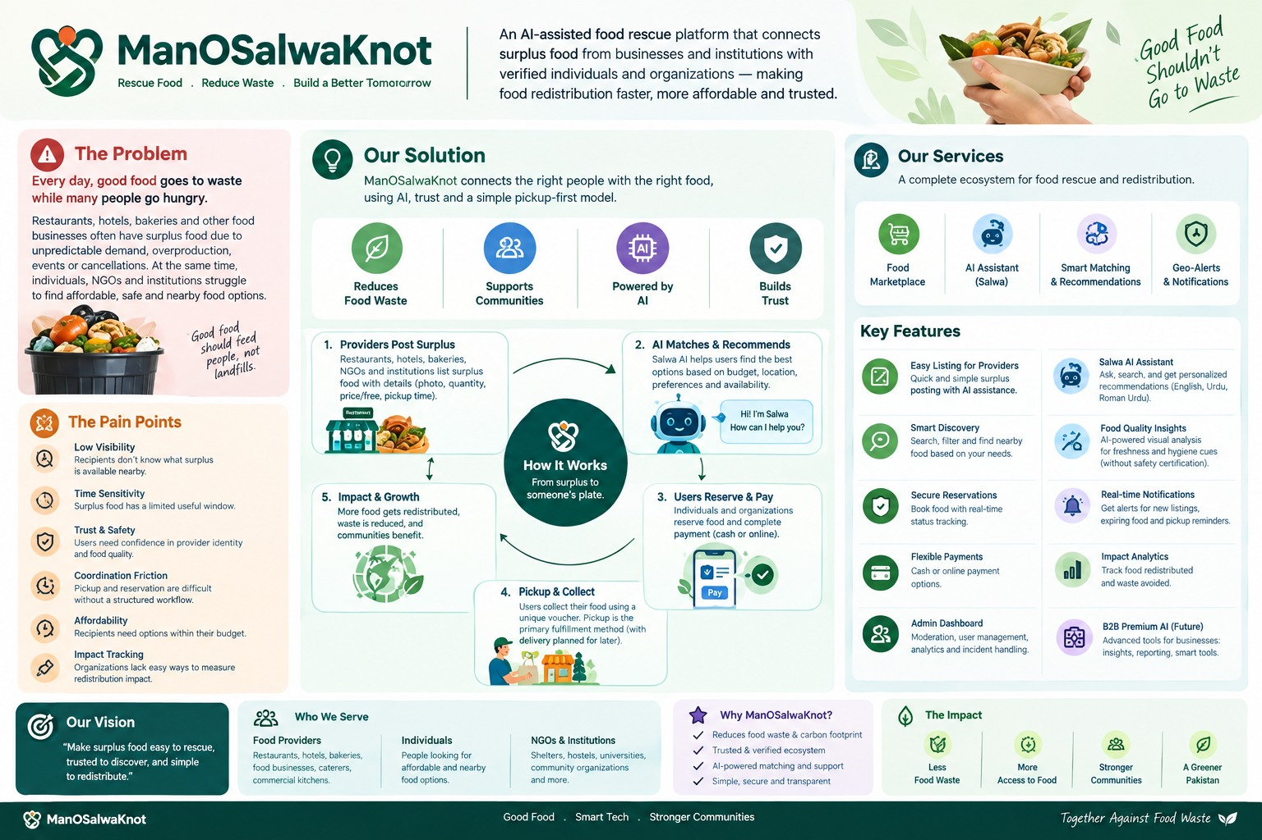
ManOSalwaKnot | Social Category | Pak Angels Final Hackathon
8

Slide 9
Methodology
System architecture
React app Live feed and map | AI Matchmaker | Ask Salwa | Photo Inspector
FastAPI backend /api/chat /api/matchmaking /api/quality/analyze /api/email/notify
Salwa chat agent
Matchmaker
Quality inspector
Alert agent
Groq + search, budget, distance and vendor-check tools
Groq + value scoring and markdown pricing
Gemini photo check + Tavily vendor check
Distance math + Resend email
Supabase (database and login)
Upstash Redis (cache and chat history)
Resend (email delivery)
ManOSalwaKnot | Social Category | Pak Angels Final Hackathon
9

Slide 10
Methodology
Agent 1: Salwa
Thought
Action
Observation
Her four tools
search_food_tool: finds live posts by query or budget
budget_calculator_tool: price per person and savings
distance_calculator_tool: Haversine distance
research_food_business_tool: vendor check via Tavily
Salwa does not guess or make up food. It decides what to do, uses a tool, reads the result, and then answers.
Example in Roman Urdu
Question: "kia koi post ha available mjy 200pkr ma chiyan"
Salwa replies in Roman Urdu with Daal Chawal (Rs 180) and Paneer Wraps (Rs 120).
ManOSalwaKnot | Social Category | Pak Angels Final Hackathon
10

Slide 11
Methodology
Agent 2: Quality inspector
Step 1: Visual scan (Gemini 2.5 Flash)
Step 2: Web check (Tavily)
Looks for discoloration, packaging seal condition and temperature risk in the photo. Gives a score from 0 to 100.
Looks up the vendor name for reviews, health department ratings and NGO certifications.
Result
Both checks are combined into one trust badge: verified, good, caution or warning. A buyer sees whether the food looks fresh and whether the kitchen has a real track record.
ManOSalwaKnot | Social Category | Pak Angels Final Hackathon
11

Slide 12
Methodology
Agents 3 and 4
For buyers
For kitchens: markdown by time left
Compares listings with budget (PKR), party size and distance. Example: Chicken Biryani at Rs 350 works out to Rs 87 per person for 4 people, 2.3 km away.
6+ hours
20-30% off
3-5 hours
40-50% off
Under 2 hours
70-80% off, or send to an NGO
Alert agent: how a drop reaches people
When a kitchen publishes a drop: load subscribers from food_subscriptions, work out each one's distance, build a branded email with food details, expiry countdown and a pickup button, and send it through Resend.
ManOSalwaKnot | Social Category | Pak Angels Final Hackathon
12

Slide 13
Technology Stack Used
Frontend
Backend
AI agents
Vision & web check
React 18.3.1
TypeScript 5.5.3
Tailwind CSS 3.4.1
Vite 5.4.8
FastAPI 0.115.0
Uvicorn 0.30.0
Python
LangChain & LangGraph
Groq (gpt-oss-120b)
Google Gemini 2.5 Flash
Tavily AI Search
Database & cache
Email alerts
Hosting
Supabase (PostgreSQL, Auth)
Upstash Redis
Resend API
Vercel (frontend)
Render (backend)
ManOSalwaKnot | Social Category | Pak Angels Final Hackathon
13

Slide 14
Database Design
Data model (Supabase / PostgreSQL)
profiles
food_posts
transactions
PK
id
PK
id
PK
id
name
FK
user_id
FK
buyer_id
1 : N
1 : N
role
restaurant / hostel / individual
food_name
FK
seller_id
tier
free / prime / ngo
quantity, price
FK
food_id
location_text, lat, lng
original_price
amount, commission
rating
expiry_time
payment_method
cash
status
available / reserved / sold / expired
status
pending / completed / cancelled
a profile is the buyer or the seller (1 : N)
How to read it: A kitchen (profile) posts food. A buyer reserves it and that creates a transaction. Cash is the payment method and the food post moves from available to reserved to sold.
ManOSalwaKnot | Social Category | Pak Angels Final Hackathon

Slide 15
Working Prototype: Live Demo
Restaurant
Individual
NGO / Hostel
Open "Post surplus"
Upload a food photo
Click "Inspect Photo AI"
Click "Publish Rescue Drop"
Open "Discover food"
Click "Reserve for Pickup"
Try AI Matchmaker (Rs 100, 1 person)
Ask Salwa in Roman Urdu
Open "Food quality AI"
Type a vendor name
Check the radius in "Profile"
Gemini scores the photo. The drop appears on the live feed and subscribers get an email.
A pickup code (#RSV-XXXX) is saved in "My activity". Salwa answers in Roman Urdu.
Tavily checks the kitchen's hygiene record. Alerts reach the inbox.
ManOSalwaKnot | Social Category | Pak Angels Final Hackathon
15

Slide 16
Limitations and Next Steps
Limitations today
Next steps
Email alerts go through the Resend sandbox gateway.
Payment is cash on pickup only.
AI features depend on outside services (Groq, Gemini, Tavily) and need internet.
Move to a verified email sending domain.
Add an online payment option if users ask for it.
Test with real kitchens and NGOs and improve from their feedback.
ManOSalwaKnot | Social Category | Pak Angels Final Hackathon
16

Slide 17
Conclusion
Good food is wasted every day while families nearby go hungry. ManOSalwaKnot closes that gap in real time.
Four AI agents handle search, trust checks, matching and alerts, so people can act fast.
One-tap reservations with cash on pickup keep it simple for everyone.
Thank you. Questions?
ManOSalwaKnot | Social Category | Pak Angels Final Hackathon
17

